Slide 1

Biostatistics, ANOVA, and Bonferroni Test
An Introduction

Slide 2

Introduction to Biostatistics
By Mahdi Mohammadzadeh
Biostatistics involves the application of statistics to a wide range of topics in biology.

Slide 3

Importance of Biostatistics
Biostatistics is essential for designing biological experiments, analyzing data, and interpreting results.

Slide 4

Analysis of Variance
One-way ANOVA:
Definition and concept:
One-way ANOVA, also known as single-factor ANOVA, is a statistical method used to compare means across three or more independent groups.
It determines whether there are statistically significant differences between the means of the groups.

Slide 5

Assumptions of one-way ANOVA:
Independence of observations: The data points within each group must be independent of each other.
Normality: The data within each group should follow a normal distribution.
Homogeneity of variances: The variance within each group should be approximately equal.

Slide 6

Two-way ANOVA
Definition and concept:
Two-way ANOVA extends the concept of one-way ANOVA by allowing the analysis of the effects of two categorical independent variables (factors) on a single continuous dependent variable.
It assesses whether there are interaction effects between the two independent variables and the dependent variable.

Slide 7

Understanding Interaction Effects
Definition and significance in two-way ANOVA:
Interaction effects occur when the effect of one independent variable on the dependent variable changes depending on the level of another independent variable.
In two-way ANOVA, interaction effects are important as they indicate that the relationship between the independent variables and the dependent variable is not additive.

Slide 8
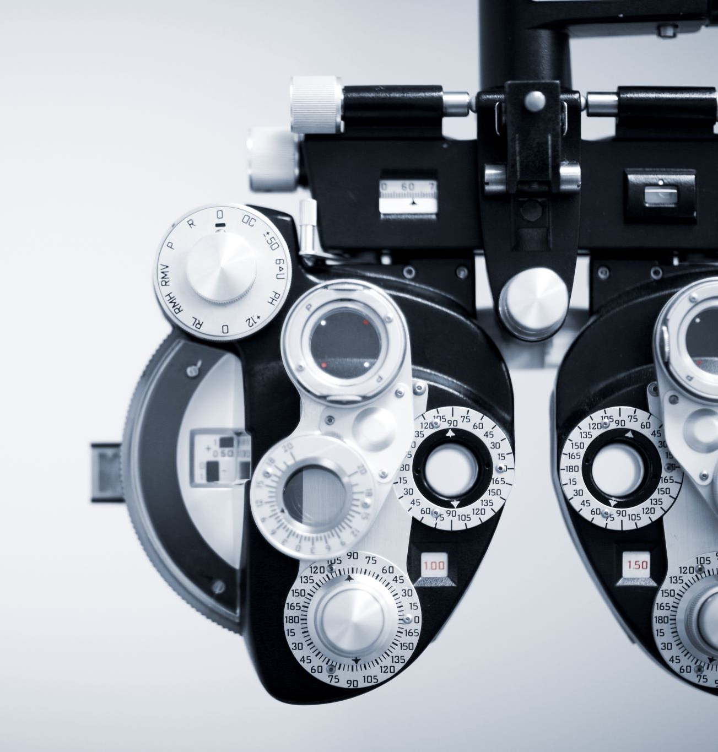
Introduction to Bonferroni Test
Definition and purpose:
The Bonferroni test is a method used to adjust for multiple comparisons in hypothesis testing.
It controls the family-wise error rate (FWER) by dividing the desired alpha level by the number of comparisons.

Slide 9

Brief explanation of multiple comparison problem:
When conducting multiple statistical tests on the same data set, the probability of making a Type I error (rejecting a true null hypothesis) increases.
The multiple comparison problem arises because conducting multiple tests increases the chance of finding a statistically significant result by chance alone.

Slide 10

Bonferroni Correction
Formula and calculation process:
To apply Bonferroni correction, we divide the desired alpha level (typically 0.05) by the number of comparisons.
The adjusted alpha level (α') represents the new threshold for statistical significance.
If the p-value for a comparison is less than α', it is considered statistically significant.

Slide 11

Explanation of how Bonferroni correction adjusts for multiple comparisons:
By lowering the threshold for significance, Bonferroni correction reduces the likelihood of falsely rejecting the null hypothesis due to conducting multiple tests

Slide 12
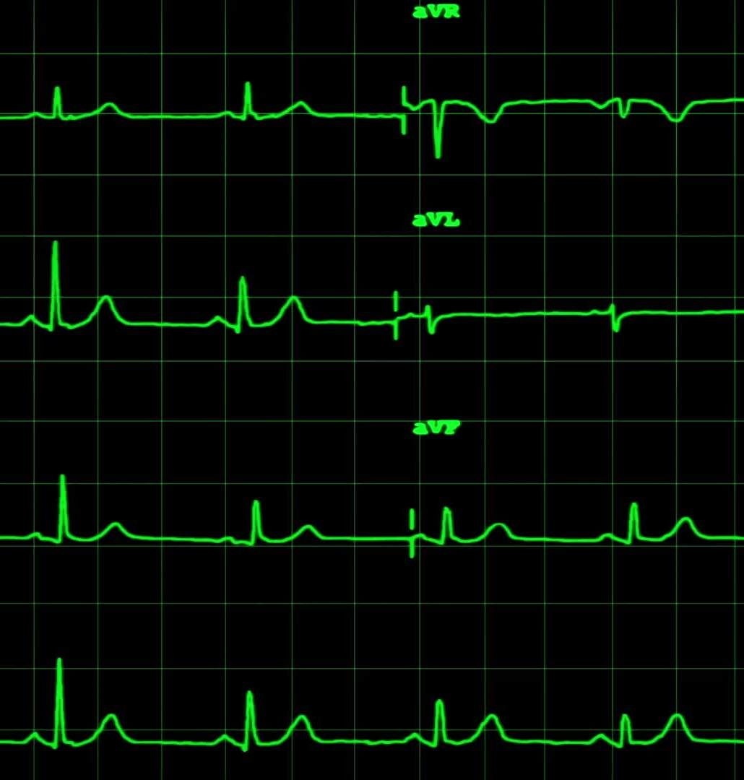
Example illustrating Bonferroni correction in practice:
Suppose a study involves testing the effects of four different treatments on a specific outcome. The Bonferroni correction would adjust the alpha level from 0.05 to 0.0125 (0.05 divided by 4) to maintain an overall alpha level of 0.05

Slide 13

Application of Bonferroni Test
Scenarios where Bonferroni test is applicable:
Bonferroni correction is commonly used in situations involving multiple pairwise comparisons, such as post-hoc tests following ANOVA.
It is also applicable in genome-wide association studies (GWAS) and other large-scale analyses involving multiple hypothesis tests.

Slide 14
Advantages and limitations of using Bonferroni correction:
Advantages include its simplicity and ability to control the family-wise error rate.
However, Bonferroni correction can be conservative, leading to increased risk of Type II errors (failing to reject a false null hypothesis) when the number of comparisons is large.

Slide 15
Differences Between One-way and Two-way ANOVA
Key distinctions in design and interpretation:
One-way ANOVA analyzes the effect of one categorical independent variable on a continuous dependent variable, while two-way ANOVA analyzes the effects of two categorical independent variables.
One-way ANOVA assesses overall group differences, while two-way ANOVA examines main effects of each independent variable and their interaction.

Slide 16

Examples illustrating when to use each type:
One-way ANOVA is appropriate when comparing means across three or more independent groups without considering any other factors.
Two-way ANOVA is suitable when studying the simultaneous effects of two independent variables on a dependent variable or when investigating interaction effects.

Slide 17

Understanding Interaction Effects
Definition and significance in two-way ANOVA:
Interaction effects occur when the effect of one independent variable on the dependent variable changes depending on the level of another independent variable.
In two-way ANOVA, interaction effects are important as they indicate that the relationship between the independent variables and the dependent variable is not additive.

Slide 18

Results

Slide 19
One-way ANOVA Results with Bonferroni-Corrected P-value:
Metric | F-statistic | P-value | Bonferroni-corrected P-value | Significant
BMI | 8.757864 | 0.003939 | 0.011818 | True
Weight | 5.068578 | 0.026798 | 0.080393 | False
Height | 0.174894 | 0.676794 | 2.030383 | False

Slide 20
Two-Way ANOVA Results
Source | Sum of Squares | df | F | PR(>F)
Group | 10.621877 | 2.0 | 0.055946 | 0.09456134
BMI | 25914.070125 | 1.0 | 272.981182 | 1.552145e-33
Group:BMI | 44.413917 | 2.0 | 0.23393 | 0.07917547
Residual | 12151.024315 | 128.0 | None | None

Slide 21
Bonferroni Post-Hoc Test Results
Weight
Group1 | Group2 | Mean Difference | p-adj | Lower | Upper
GLP1-ins | SPSS | -0.7235 | 0.9 | -6.0114 | 4.5644
GLP1-ins | SGLT2 | -0.9054 | 0.9 | -5.7632 | 3.9525
SPSS | SGLT2 | -0.1819 | 0.9 | -5.0502 | 4.6863

Slide 22
Height
Group1 | Group2 | Mean Difference | P-adj | Lower | Upper
GLP1-ins | SPSS | 0.0168 | 0.9 | -0.1022 | 0.1361
GLP1-ins | SGLT2 | 0.0645 | 0.9 | -0.0432 | 0.1723
SPSS | SGLT2 | 0.0477 | 0.9 | -0.0729 | 0.1682

Slide 23

Insights

Slide 24

Weight
ANOVA Results: The ANOVA test for Weight showed a p-value of approximately 0.0583 when comparing GLP1-ins and SGLT2 groups, which is just above the conventional significance level of 0.05. This suggests a borderline significant difference in weight between these two groups.
Post-Hoc Results: The Bonferroni post-hoc test did not show a significant difference between any pairs of groups.
Interpretation: While there appears to be some difference in weight between GLP1-ins and SGLT2 groups, this difference is not statistically significant after adjusting for multiple comparisons. This could suggest that the effect size is small or that the sample size may not be large enough to detect a significant difference.

Slide 25

Height
ANOVA Results: The ANOVA test for Height did not show any significant differences between the groups.
Post-Hoc Results: Similarly, the Bonferroni post-hoc test did not indicate any significant differences between pairs of groups.
Interpretation: There are no significant differences in height between the GLP1-ins, SGLT2, and SPSS groups. This suggests that height is similar across all groups.

Slide 26
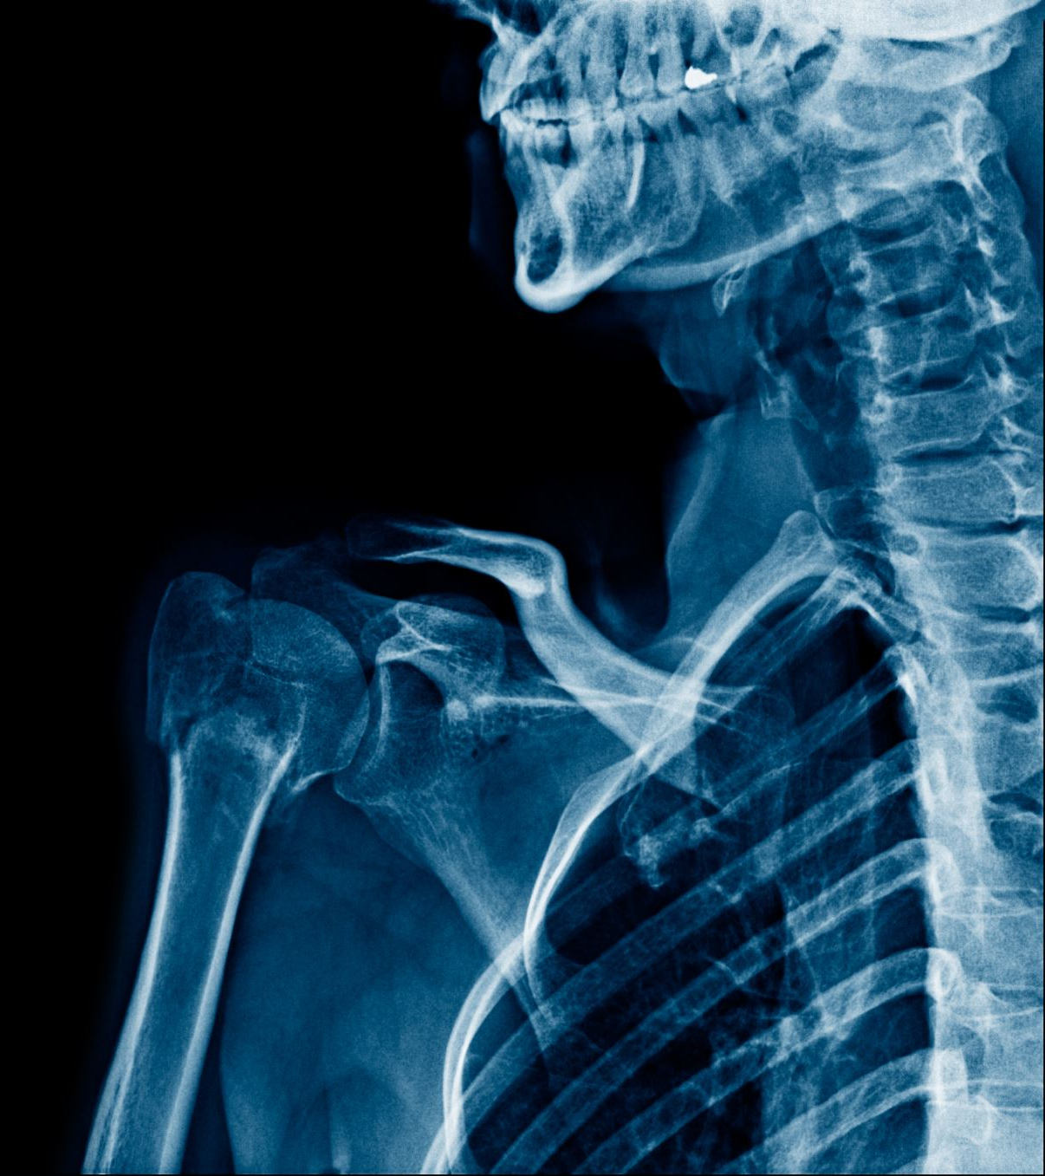
Body mass index
ANOVA Results: No significant differences in BMI were found between the groups according to the ANOVA test.
Post-Hoc Results: The Bonferroni post-hoc test also did not show significant differences between any pairs of groups.
Interpretation: BMI, which is a key indicator of body composition, is similar across the three groups. This suggests that the treatment groups do not differ significantly in terms of BMI.

Slide 27

Metformin
ANOVA Results: The ANOVA test for Metformin levels showed no significant differences between the groups.
Post-Hoc Results: The post-hoc tests corroborated these findings, showing no significant differences between pairs of groups.
Interpretation: The use of Metformin is consistent across the groups, indicating no significant differences in Metformin treatment between GLP1-ins, SGLT2, and SPSS groups.

Slide 28
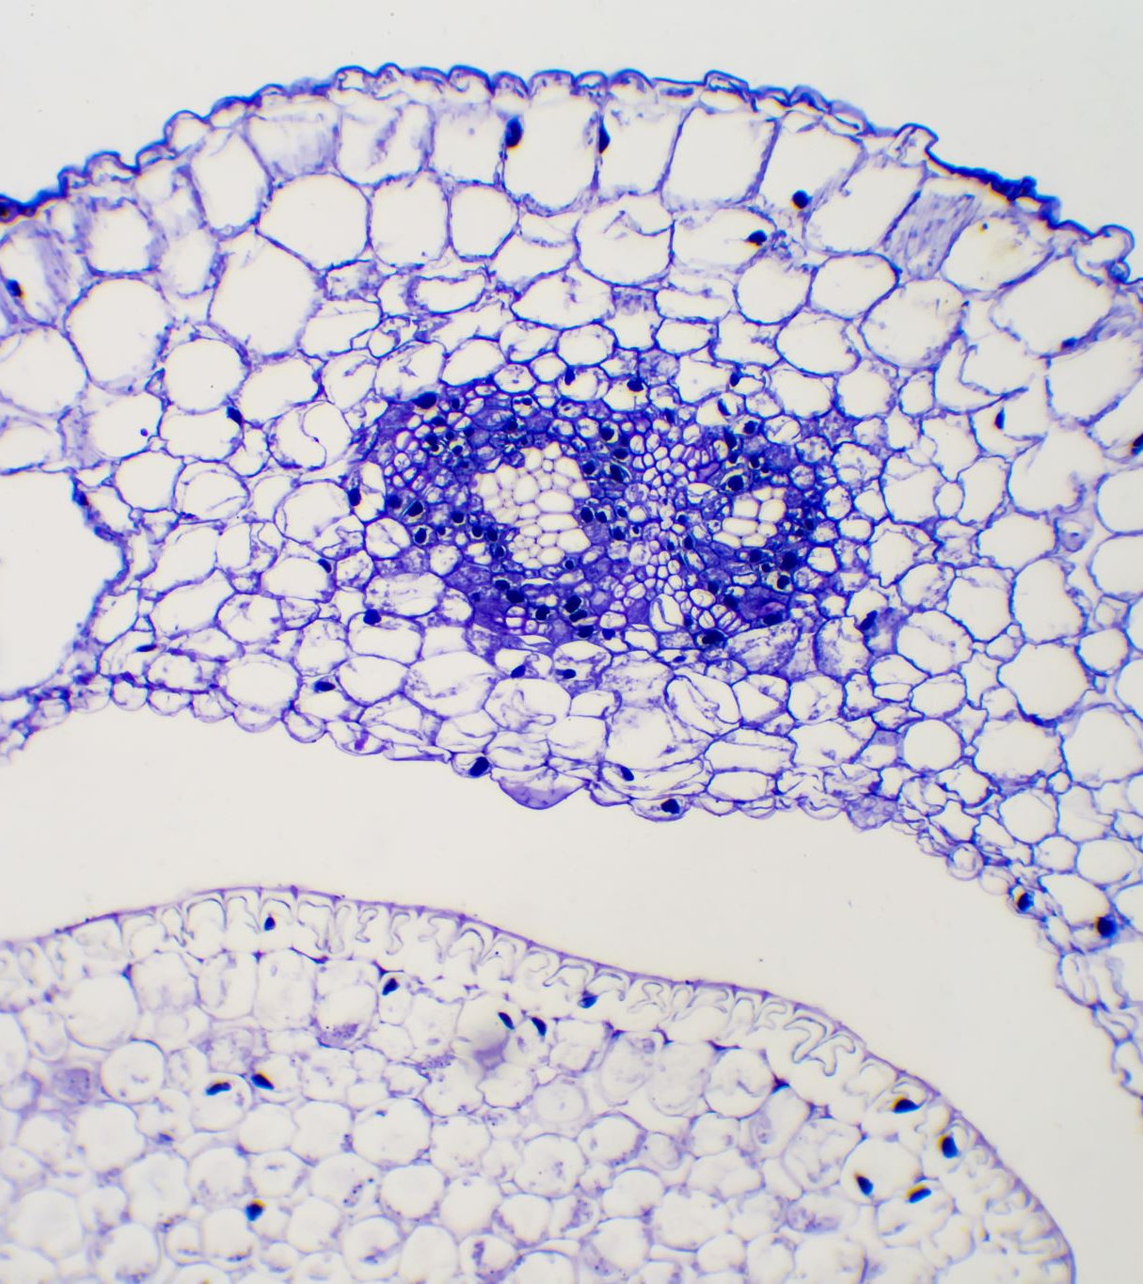
Hemoglobin A1C
ANOVA Results: HbA1c levels did not differ significantly between the groups based on the ANOVA test.
Post-Hoc Results: The Bonferroni test showed no significant differences between any of the groups.
Interpretation: HbA1c, a measure of long-term blood glucose control, is comparable across the groups. This suggests that the different treatments do not have a significant differential impact on HbA1c levels.

Slide 29
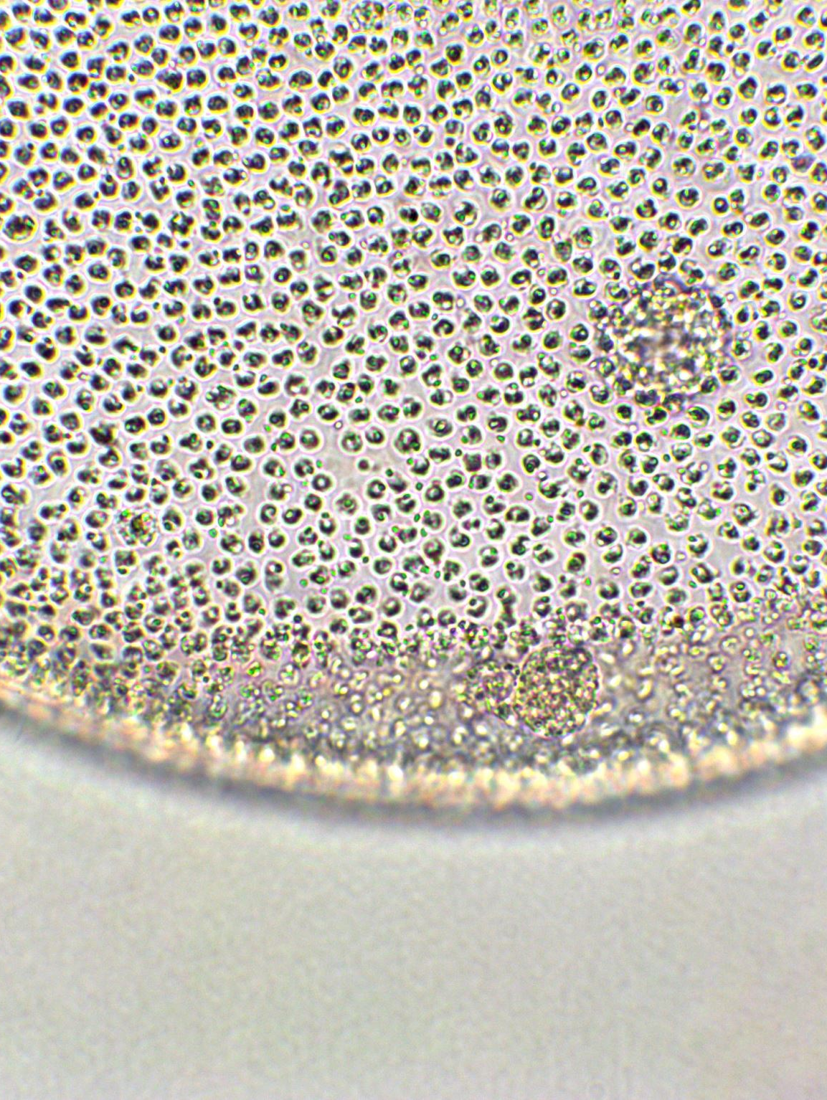
GFR (Glomerular Filtration Rate)
ANOVA Results: The ANOVA test for GFR did not show significant differences between the groups.
Post-Hoc Results: The post-hoc tests also did not indicate any significant differences between the groups.
Interpretation: GFR, an indicator of kidney function, is similar across all treatment groups. This indicates no significant differential impact of the treatments on kidney function as measured by GFR.

Slide 30

Creatinine
ANOVA Results: There were no significant differences in creatinine levels between the groups according to the ANOVA test.
Post-Hoc Results: The Bonferroni post-hoc test confirmed that there are no significant differences between any pairs of groups.
Interpretation: Creatinine levels, another indicator of kidney function, do not differ significantly across the groups, reinforcing the finding that kidney function is not differentially affected by the treatments.

Slide 31

Conclusion
The analysis revealed that BMI significantly affects weight across all treatment groups, indicating its critical role in weight management. However, no significant differences were observed between the GLP1-ins, SGLT2, and SPSS groups in terms of their impact on Weight, Height, BMI, Metformin usage, HbA1c levels, GFR, and Creatinine levels. These findings suggest that the treatments have similar effects on these health parameters, emphasizing the importance of considering individual BMI in treatment plans rather than focusing solely on the type of medication.

Slide 32

Grazie per il tuo tempo

